Slide 1
Results of a Spatial Stock Assessment for Alaska Sablefish
Matt Cheng, Dan Goethel
CIE 2026

Slide 2
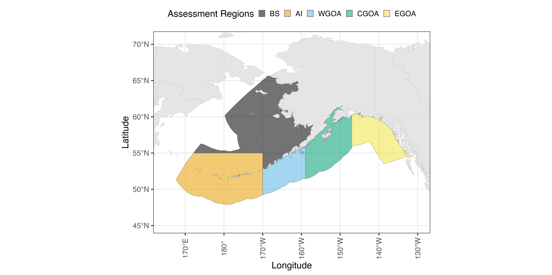
Overview and Notes
Area: Alaska-wide stock
2 Models presented:
3-region model
BS, AI, WGOA + CGOA + EGOA
5-region model
BS, AI, WGOA, CGOA, and EGOA
Model parameterization generally follows Cheng et al. (2025) and the proposed single-region / fleets-as-areas configurations

Slide 3
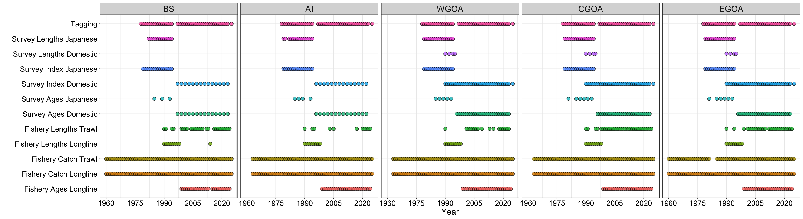
Data Summary
Note: Longline Fishery and Domestic Survey are primary drivers of population dynamics

Slide 4
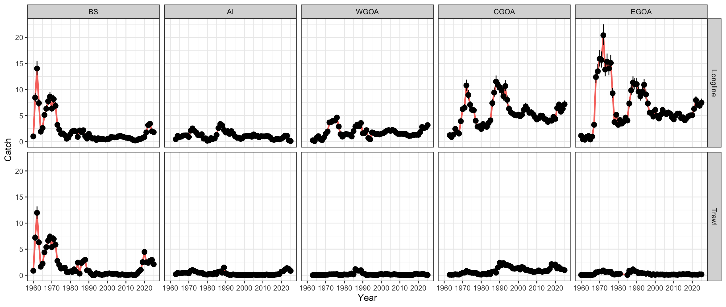
Catch
Higher removals from longline fleet in the GOA
Removals tend to be higher by trawl fleet in the BS, though still small in comparison to longline
Note BS trawl removals were historically high
Potentially suggests high historical BS abundance

Slide 5
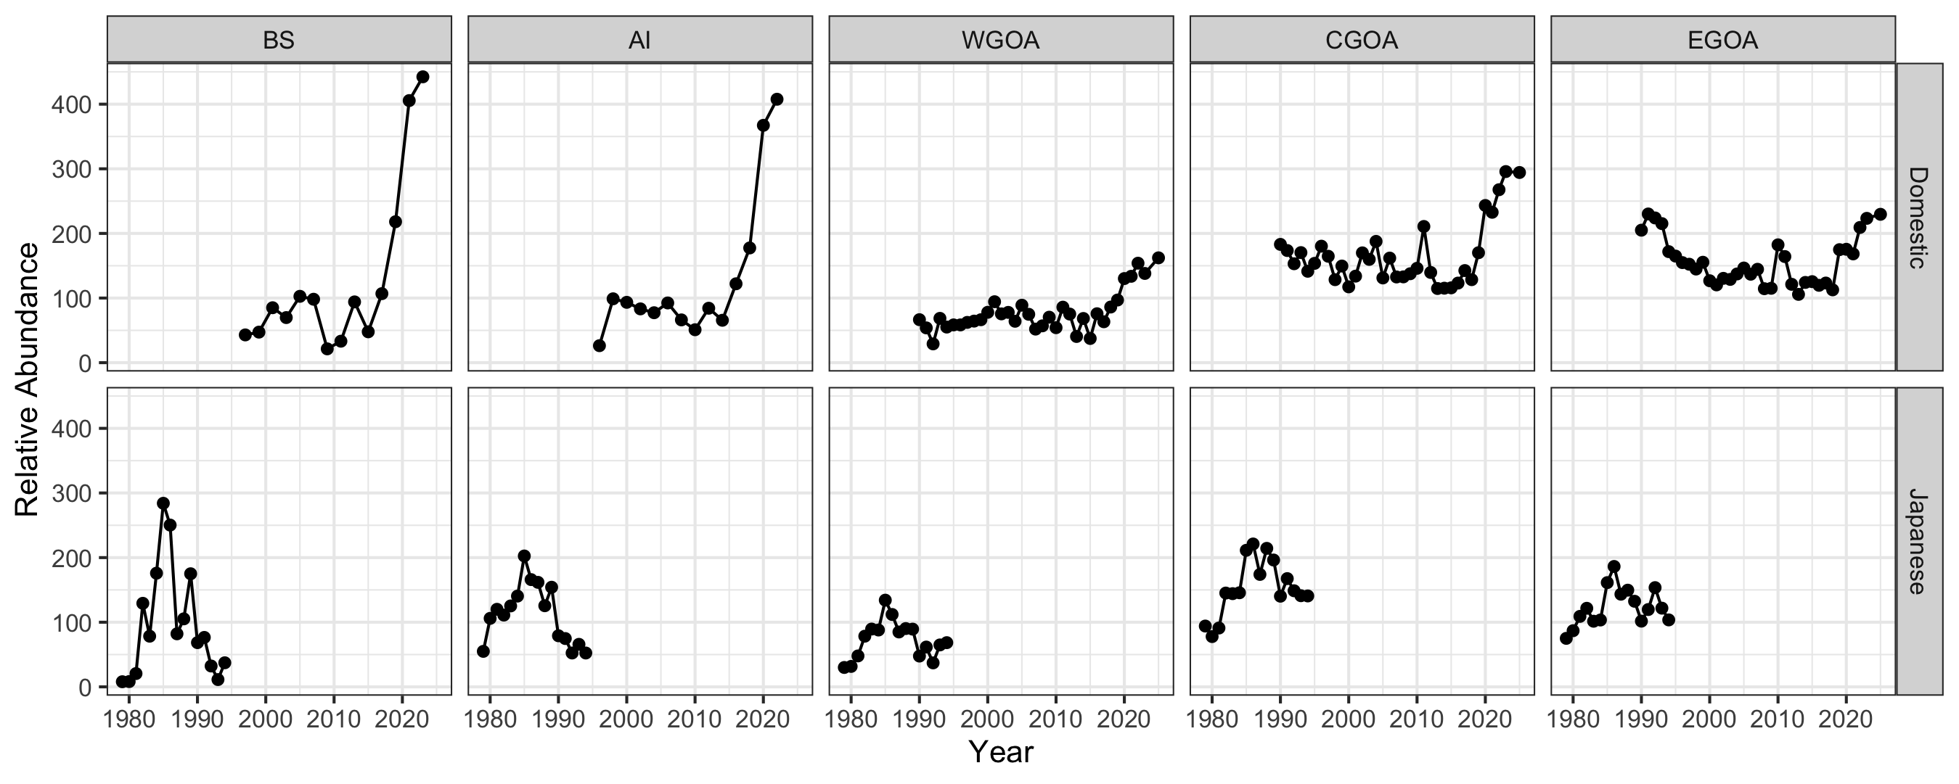
Indices
Historically, indices have been higher in GOA regions
GOA is likely the center of AK sablefish distribution
Recent increases in BS, AI due to recruitment events

Slide 6
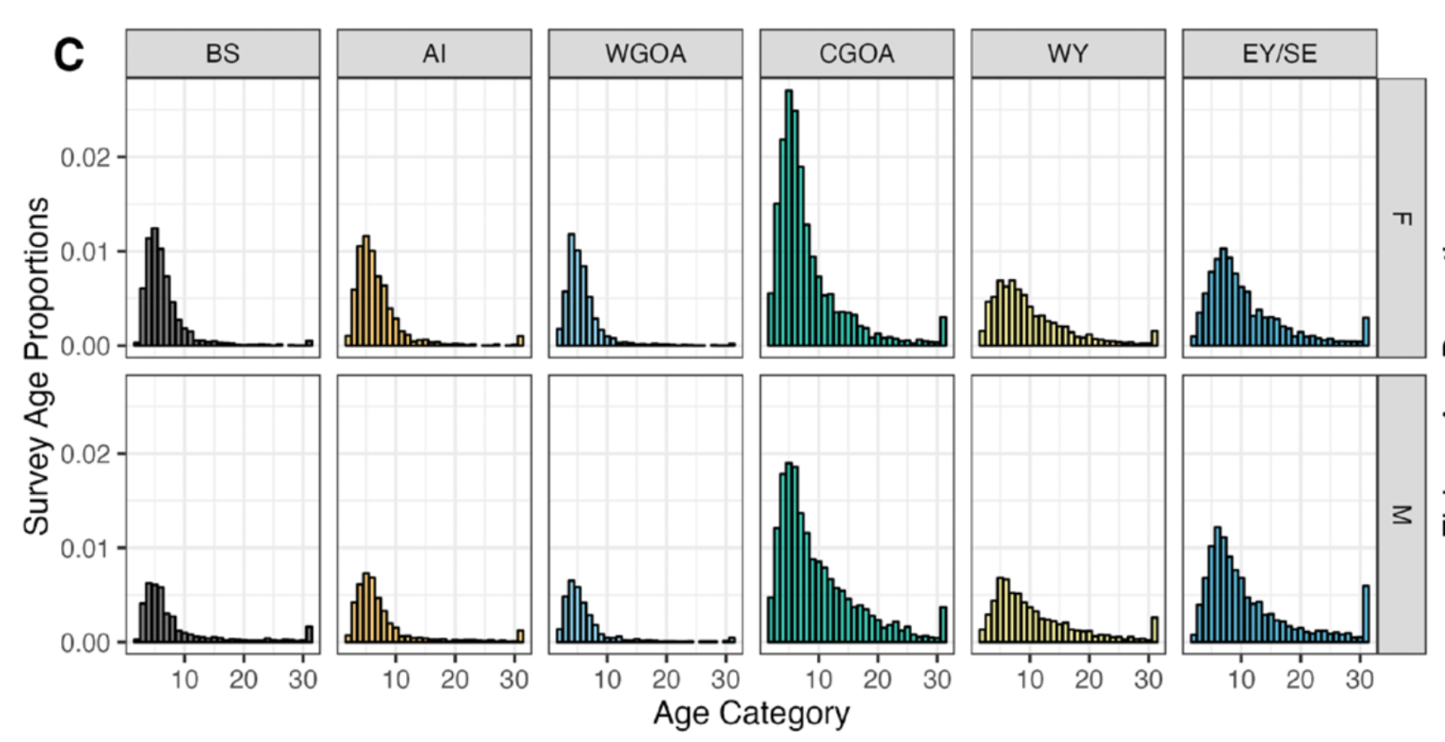
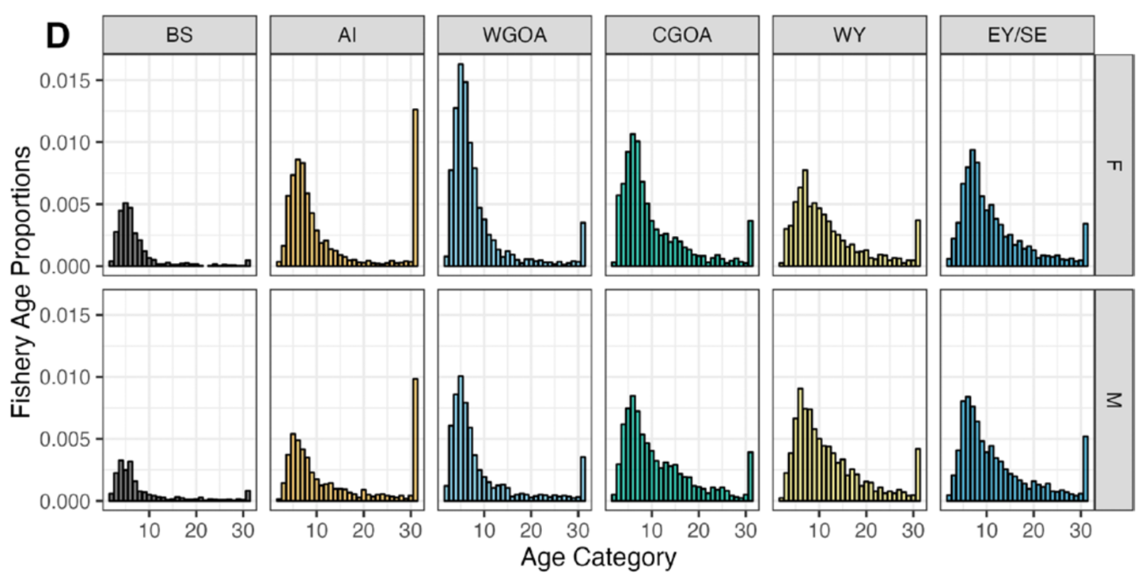
Compositions
Generally younger fish in the BS and AI
AI Fishery ages occasionally observes a large number of old individuals
Older fish in the GOA
Likely due to ontogenetic movement dynamics

Slide 7
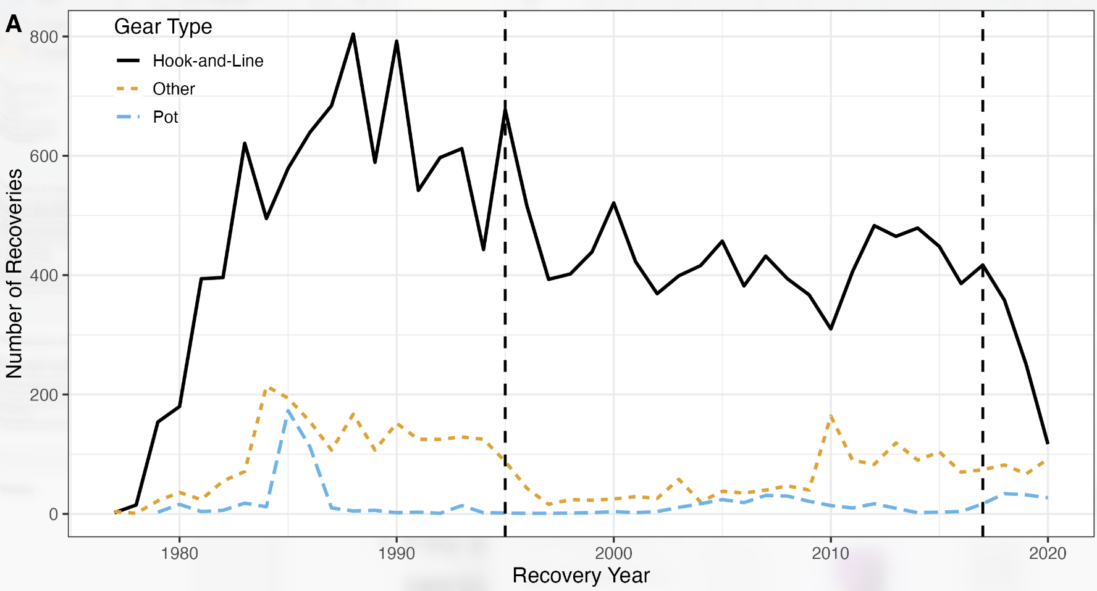
Tagging Data
Tagging with conventional tags since early 1970s: > 40 yrs
~413,000 total tag releases
~ 3,500 adult sablefish tagged/yr on the annual LL survey
~38,500 total recoveries
Mostly from the fixed-gear fleet in the GOA
Integrating tagging data in an assessment framework requires knowing / estimating:
Tag reporting / non-reporting rates
Tag shedding
Tag induced mortality
Only considering fixed-gear recaptures (hook-and-line and pot) in this model

Slide 8
Model Structure (5-region model)
Model parameterization follows Cheng et al. (2025) and the proposed single-region / fleets-as-areas configurations
5-areas, sex-specific, age-structured
Movement estimated in 3 age blocks
Spatially-varying recruitment
Sex-specific time-invariant logistic selectivity
Spatially-invariant catchability
Tagging data follows a Multinomial Release-conditioned likelihood
3 spatially-invariant time-blocks to account for fishery changes
1208 parameters estimated

Slide 9
Model Structure (3-region model)
Same parameterization as 3-region model
3-areas, sex-specific, age-structured
BS, AI, WGOA + CGOA + EGOA
723 parameters estimated

Slide 10
Subsequent results generally focus on 5-region model for brevity; 3-region model model results are relatively similar

Slide 11
Fit to indices (5-region model)
Adequate fits to all indices across regions
Slight over-prediction of index in EGOA in recent years
Potentially due to time-varying movement?

Slide 12
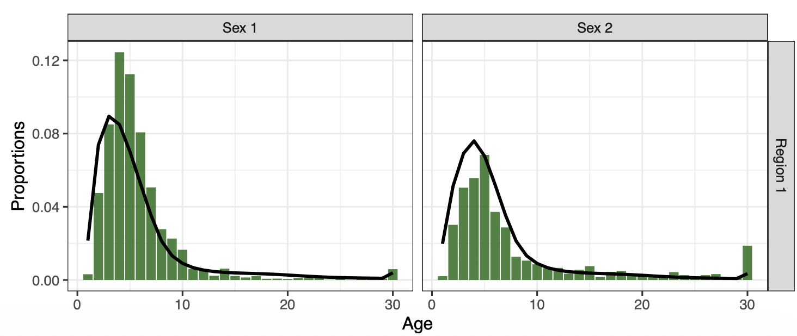
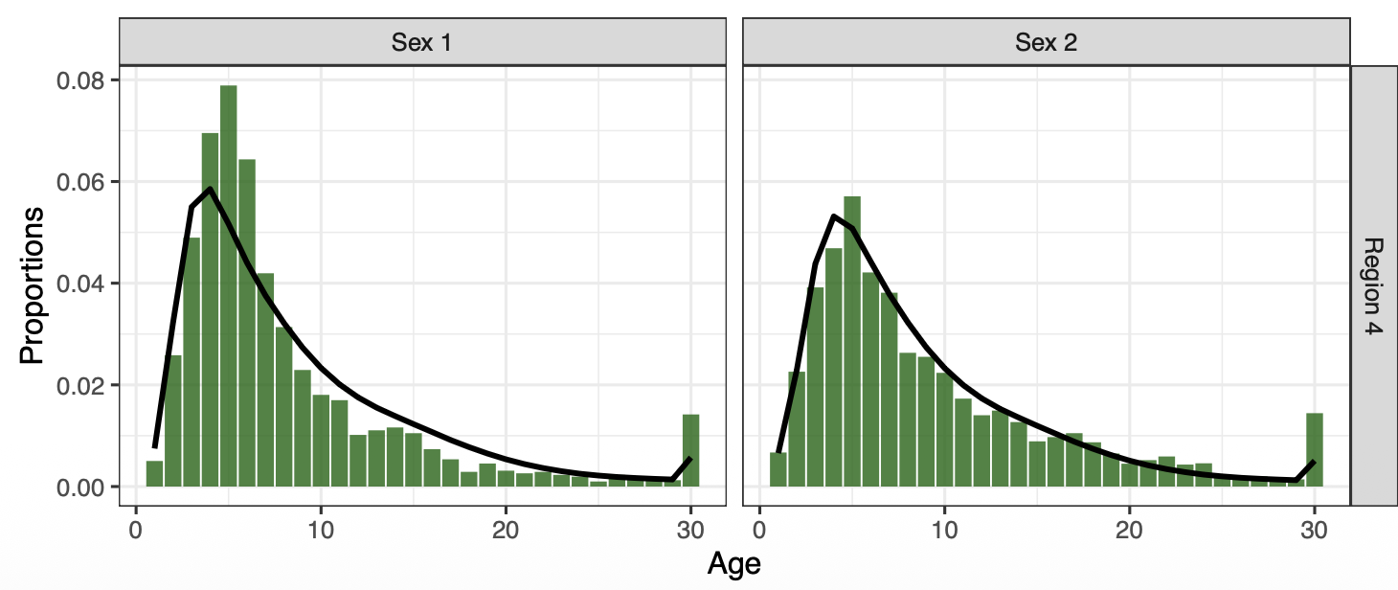
Fit to compositions (5-region model)
Females
Males
Generally acceptable fits to composition data for fishery and domestic longline fleets on aggregate
Sparser age compositions in the BS and AI
Trouble fitting fishery AI plus group
Underprediction of younger-intermediate-aged individuals
BS
Females
Males
CGOA
Survey compositions

Slide 13
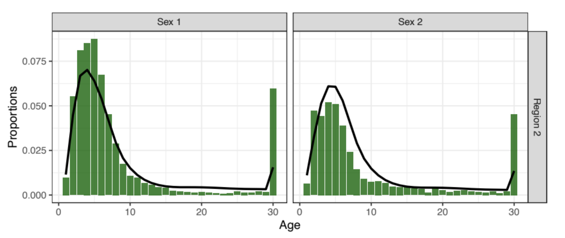
Fit to compositions (5-region model)
Generally acceptable fits to composition data for fishery and domestic longline fleets on aggregate
Sparser age compositions in the BS and AI
Trouble fitting fishery AI plus group
Underprediction of younger-intermediate-aged individuals
Females
Males
AI
Fishery compositions

Slide 14
Fits to tagging data (5-region model)
Fits in the early period are generally adequate, but worsens in later periods
Misfits in later periods might be due to switch towards pot gear?
Potentially need more flexibility in tag reporting rates or movement rates?
i.e., spatially-varying?

Slide 15
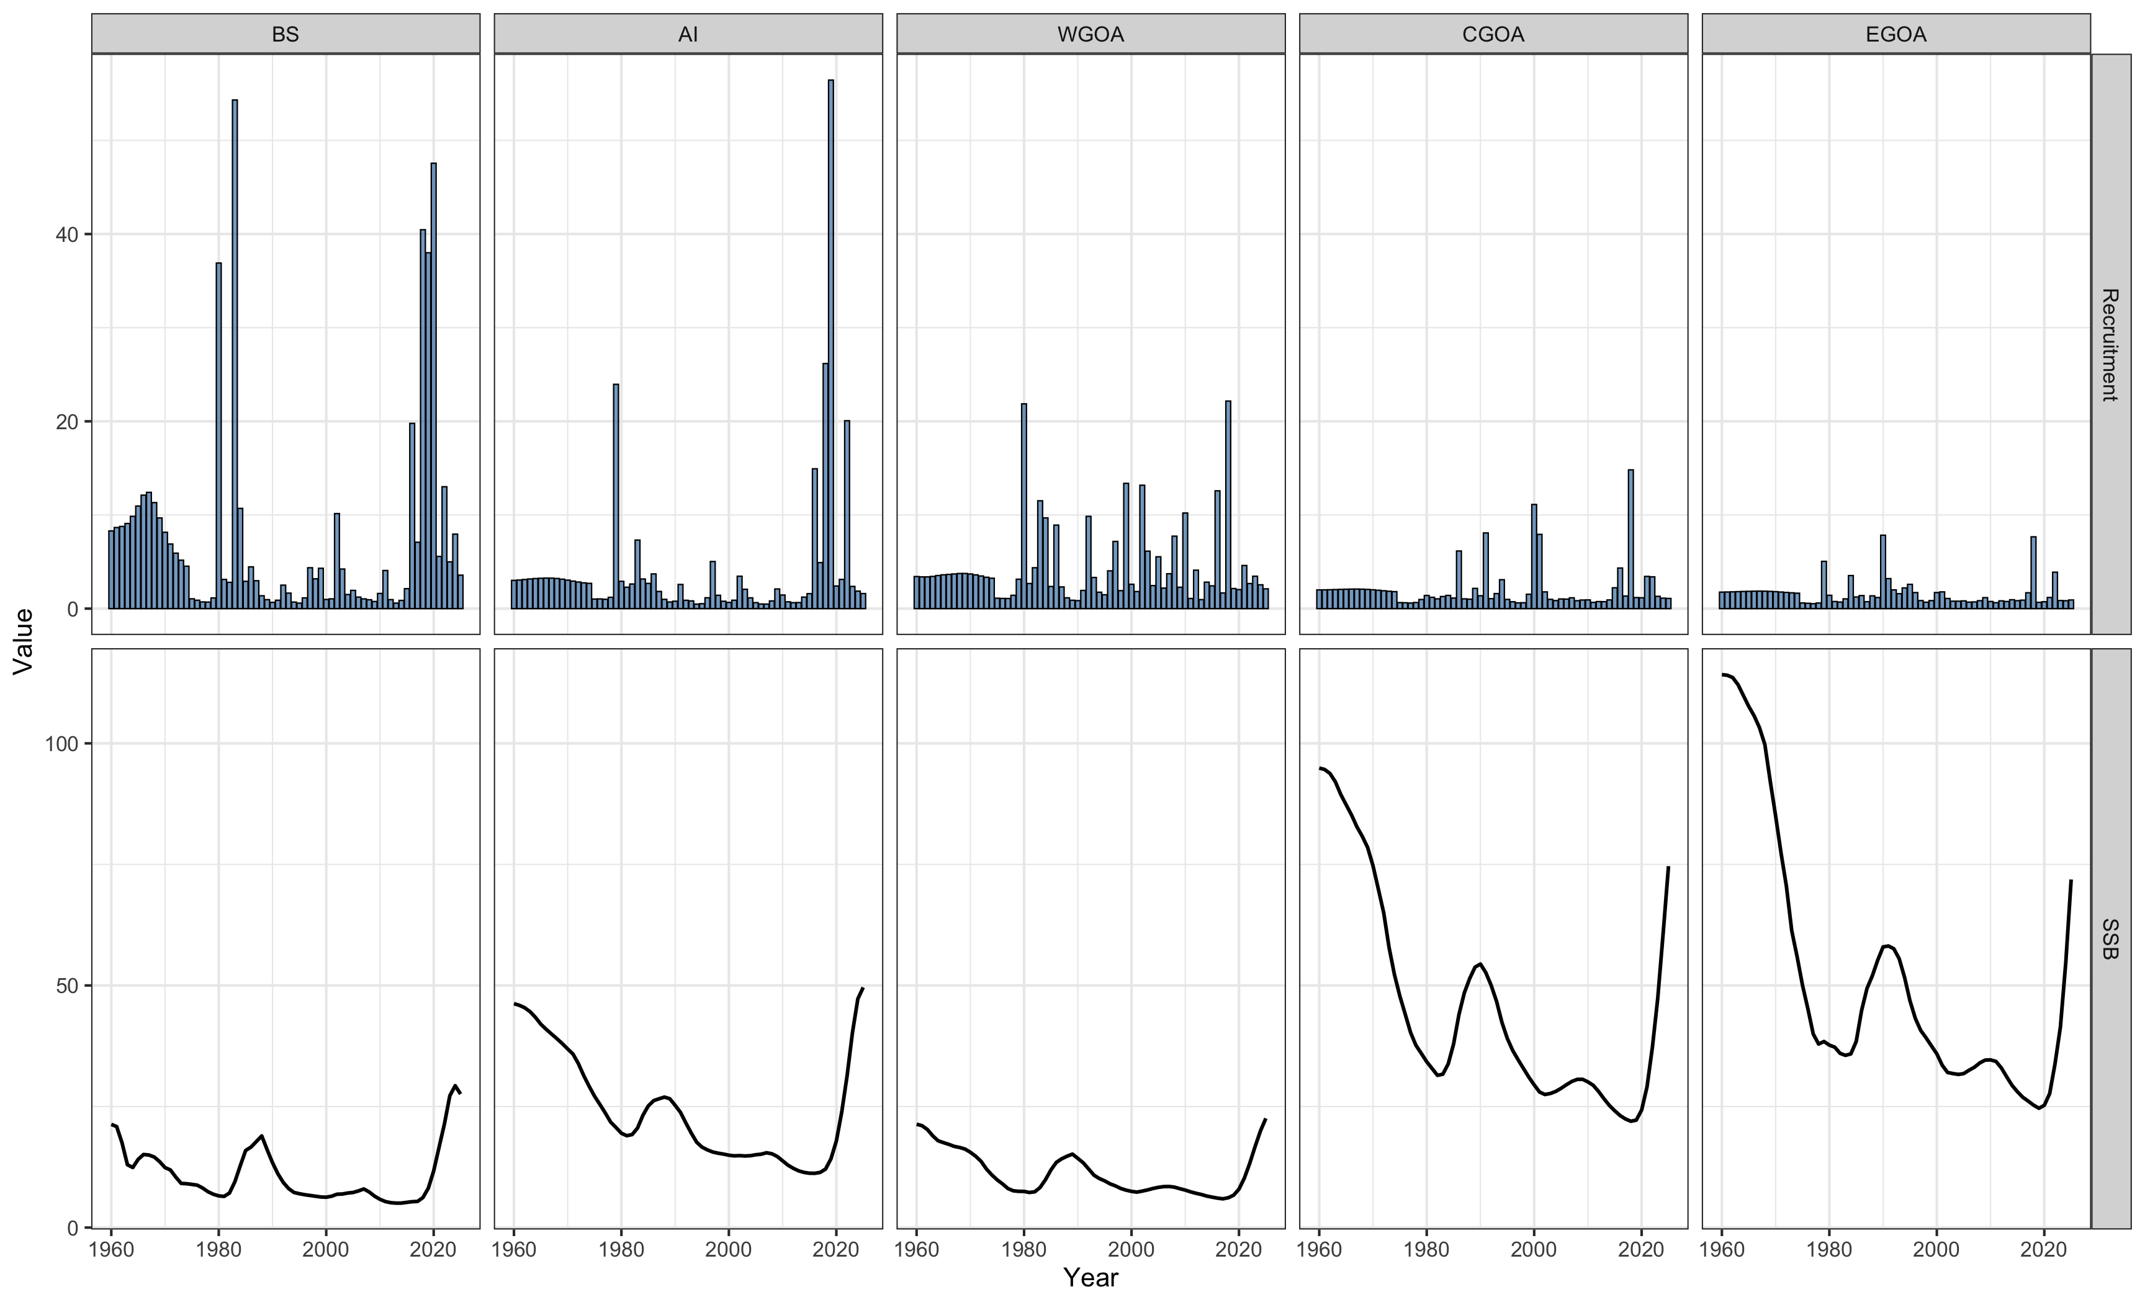
Time-series (5-region model)
High recruitment in western regions (BS and AI), but lower SSB
Lower recruitment in eastern regions (GOA), but higher SSB
Disconnect between recruitment and SSB likely due to movement

Slide 16
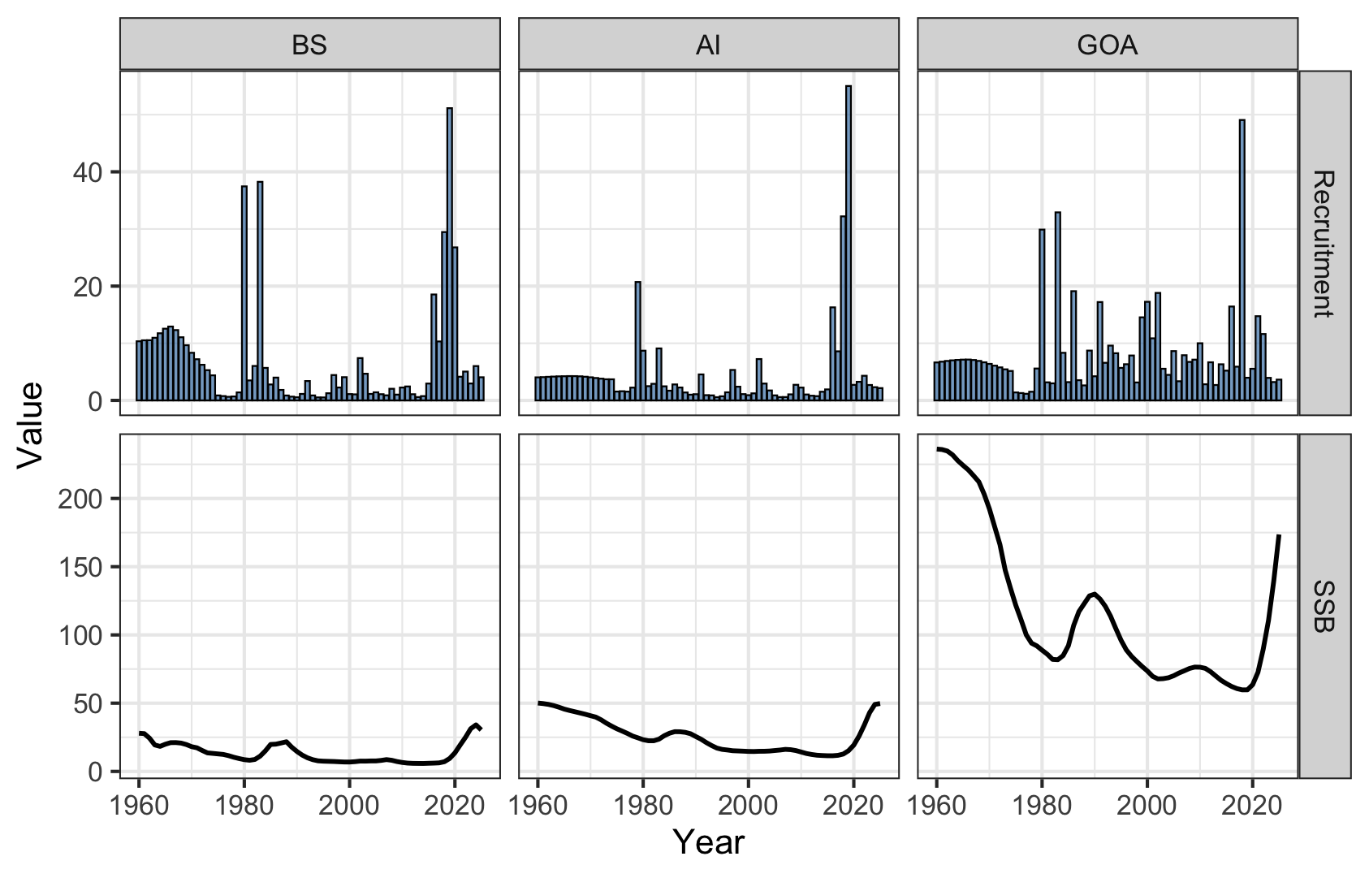
Time-series (3-region model)
High recruitment in western regions (BS and AI), but lower SSB
Lower recruitment in eastern regions (GOA), but higher SSB
Disconnect between recruitment and SSB likely due to movement

Slide 17
Time-series comparison
Similar patterns and scale
However, trends in recruitment show some subtle differences
5-region model tends to predict above avg recruitment in later period
Potentially due to more refined movement estimates, relative to three-region model? (higher resolution movement)

Slide 18
Retrospective performance (5-region model)
Moderate positive retrospective patterns in SSB across all regions
This could partly be attributed to annual revisioning of recruitment and movement estimates (model instability)
BS
AI
WGOA
CGOA
EGOA

Slide 19
Retrospective performance (3-region model)
Similar performance to the 5-region model
However …
Certain peels lead to very low recruitment estimates in the AI
Similar issue encountered in the closed-loop simulation
Likely because of annual revisioning of recruitment and movement estimates (model instability)
BS
AI
GOA

Slide 20
Assessment summary
Both 5- and 3-region models fit indices well; compositions fits are adequate, though underpredict young-to-intermediate age classes
Fishery AI plus group cannot be adequately fit
Inverse SSB–recruitment relationship across space:
High SSB in the east with low recruitment
Low SSB in the west with high recruitment
Increase in model run times
1-region / FAA models: ~ order of seconds
3-region: ~ 5 minutes
5-region: ~ 25 minutes
Reduced ability to explore a large number of model alternatives within a given assessment cycle
Retrospective performance is moderate, but some peels show instability (AI recruitment drops to low numbers)
Annual tuning may be necessary rather than running the model on autopilot

Slide 21
Future directions and outstanding challenges
May need to model time-varying movement to account for potential changes in movement dynamics
Difficult to estimate despite long time-series of tagging data
Dealing with tagging nuisance parameters and data-weighting
May need to estimate time-and spatially-varying tag reporting rates
Develop improved diagnostics for assessing tagging data fits
Understand implications of weighting tagging data in conjunction w/ other data sources
Explore spatially-and time-varying fishery selectivity
Potentially difficult given sparse data and increase in the # of parameters

Slide 22
Extra slides

Slide 23
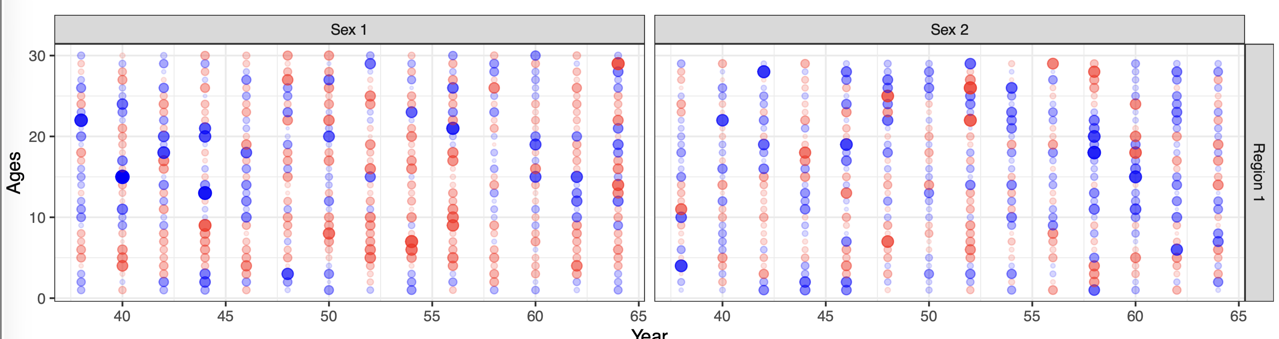
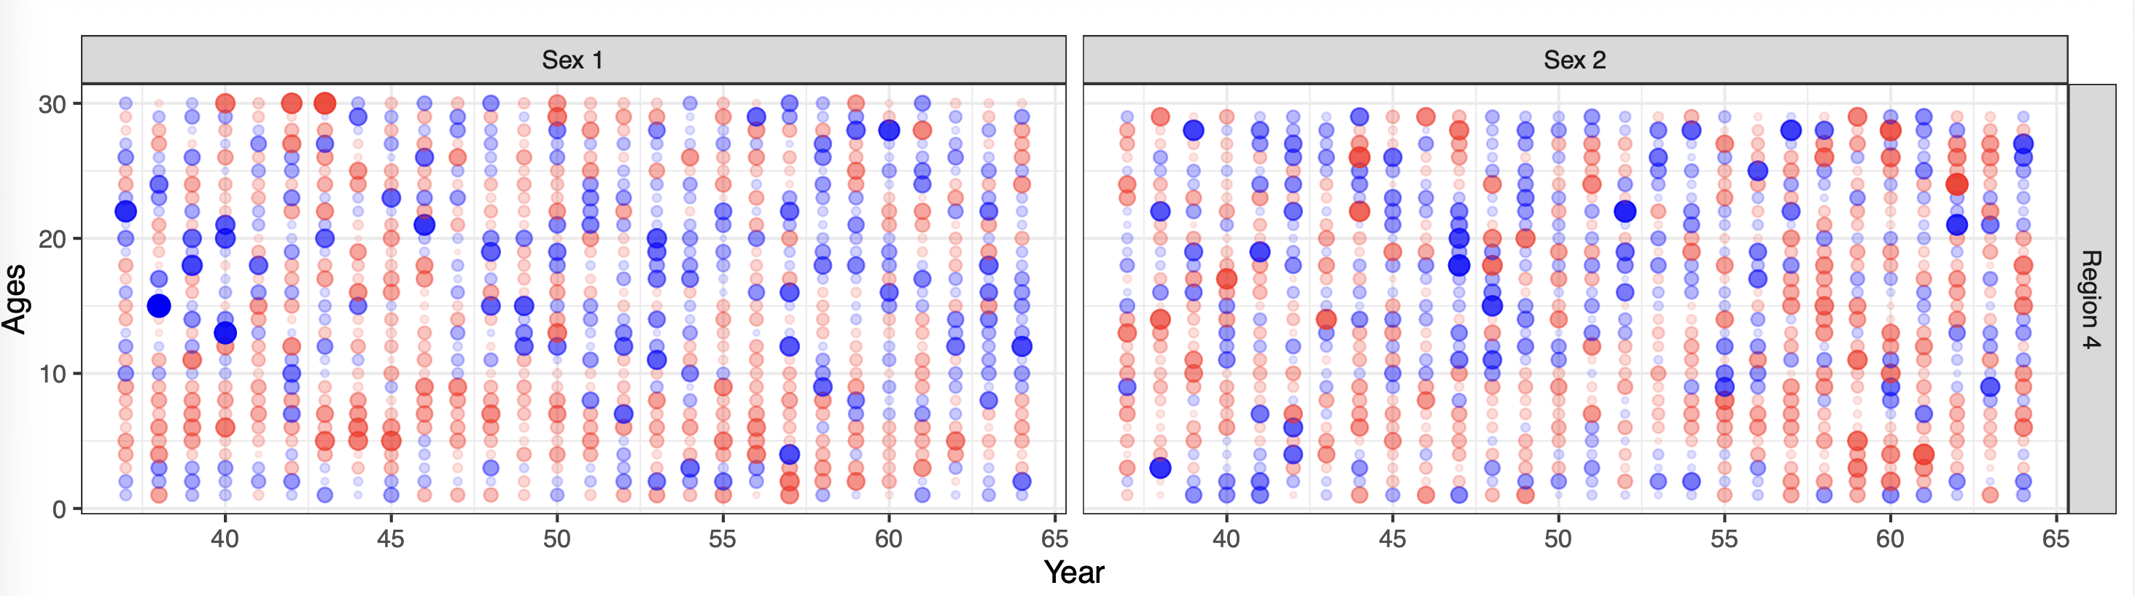
Fit to compositions (5-region model)
Females
Males
Generally acceptable fits to composition data for fishery and domestic longline fleets on aggregate
Sparser age compositions in the BS
Positive residuals for large recent recruitment events
Potentially underpredicting recruits
BS
Females
Males
CGOA
Survey compositions

Slide 24
Fit to indices (3-region model)
Similar results to 5-region model
Generally adequate fits to all indices and regions
Slight over-prediction of index in EGOA in recent years

Slide 25
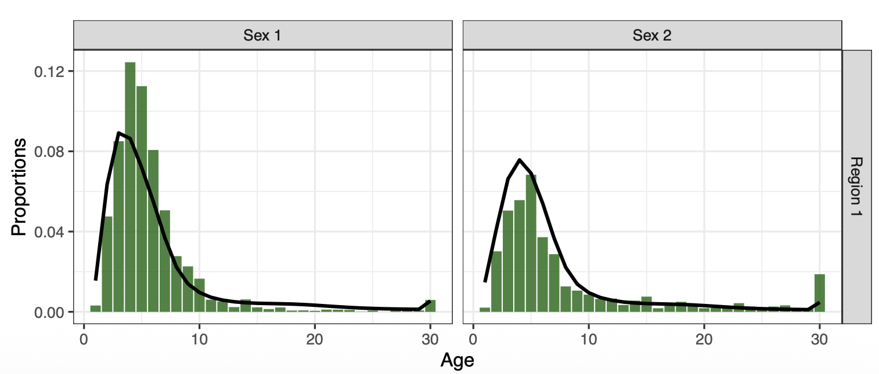
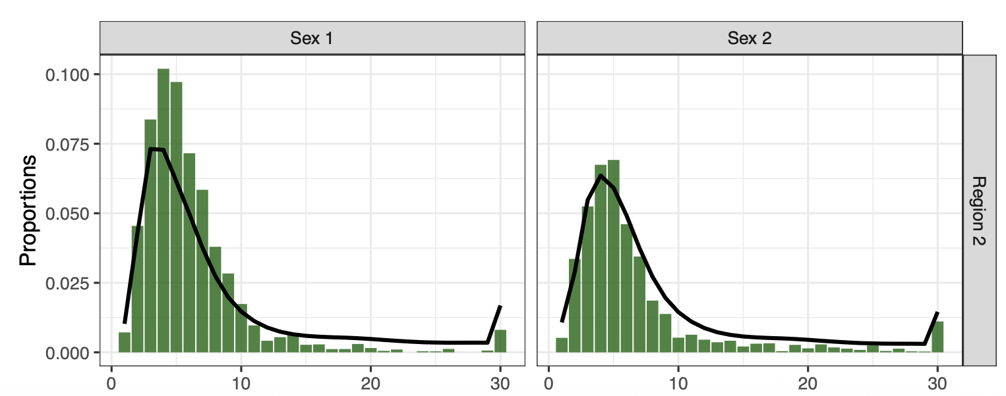
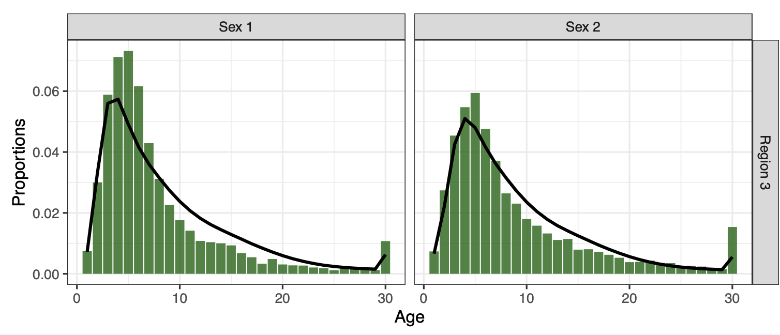
Fits to compositions (3-region model)
Females
Males
Similar patterns to 5-region model
Sparse data in BS and AI (trouble fitting AI plus group in fishery)
General overprediction of old individuals in GOA
Similar cohort patterns as in 5-region model
BS
Females
Males
AI
Females
Males
GOA
Survey compositions

Slide 26
Fits to tagging data (3-region model)
Similar results to 5-region model
Fits in the early period are generally adequate, but worsens in later periods
Potentially need more flexibility in tag reporting rates or movement rates?

